Slide 1









Jennifer Weiming Anastasiya

Slide 2


Slide 3


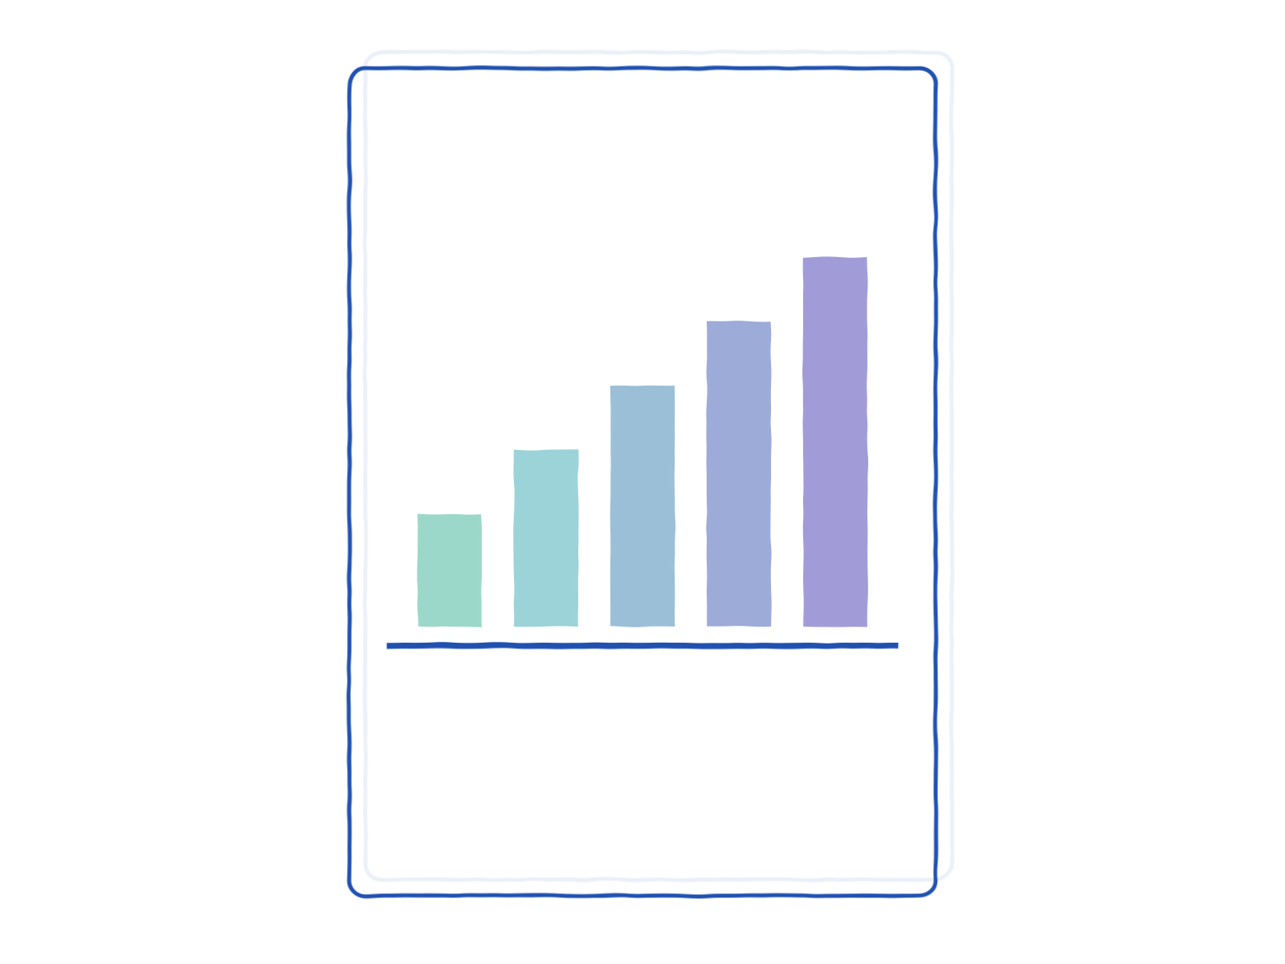
Our Project
Purpose
Target Audience
Data Source
Understand what factors can influence a students performance on a standardized test
Parents and school representatives to provide better ed. programs
Data set is used from Kaggle
Notes:
Purpose of this project

Slide 4

Three Main Problems
Is there a correlation between test prep and a higher total score?
Total score = reading + math + writing
2. Which variable highly contributes to students exam performance?
3. Predict the overall test score from inputted variables
Notes:
In this analysis report, we address three main problems.
The first problem is determining whether or not there is a correlation between receiving a test prep and getting a higher total test score. This test score is calculated by combining Reading, Math, and Writing scores.
The second problem is analyzing if a student’s parental level of education has an effect on the student’s performance on the standardized test.
The third problem, we predict the overall test score given the attributes from our data set.

Slide 5


Exploratory Data Analysis
How we analyzed our data
Notes:
Jeniffer

Slide 6
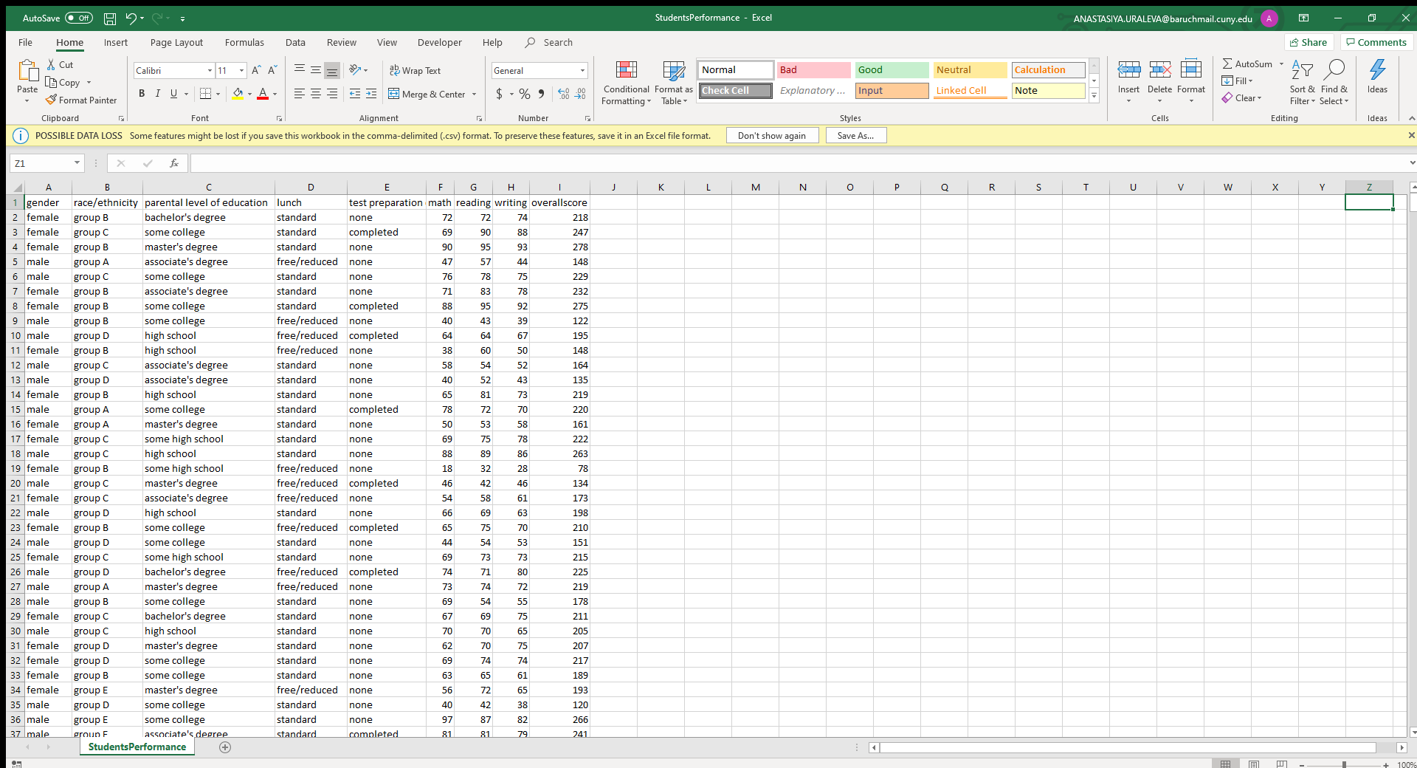
Exploratory Data Analysis
Used Kaggle dataset and made questions on what to do with this data
Do we predict each score? Or do we aggregate?
Decided to sum up all the scores so that we cover all the variables and see its effect across all the provided variables
Original data file with categorical variables
and 3 exam scores
Added overall score
(math+ reading + writing)
Notes:
Data - get graphs from Weiming ---- how we explored our data

Slide 7
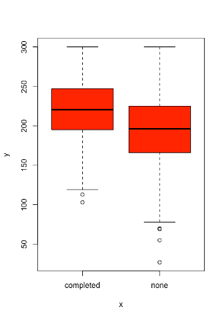
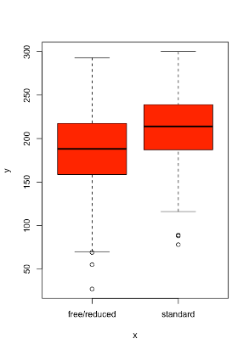
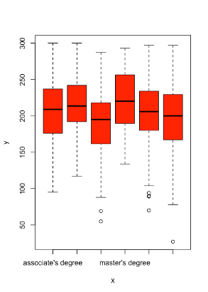
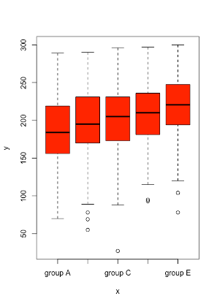
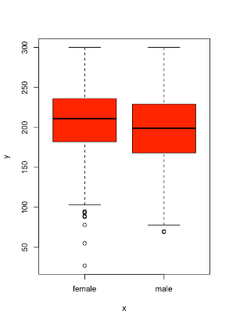
Boxplot

Slide 8
Linear Regression
Regression Tree
Random Forest
Data Mining Methods
Which methods we chose
Notes:
(Weiming) --

Slide 9
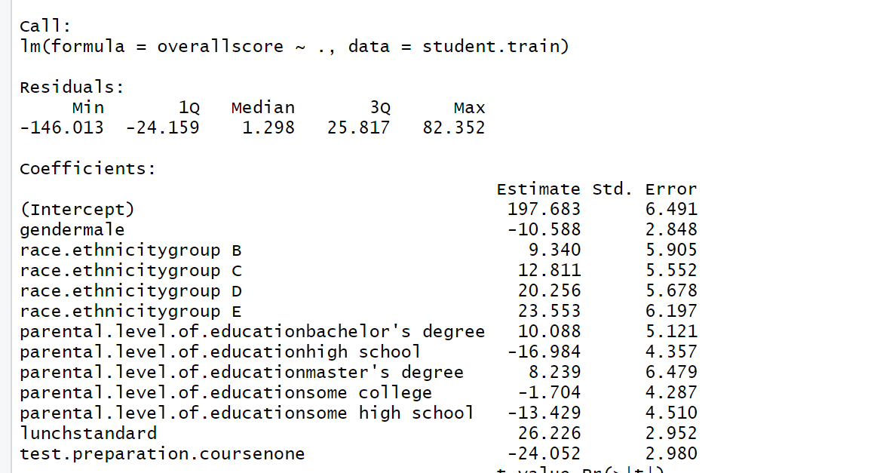
Linear Regression
Used 70% of the data for training and the 30% for testing
Used the overallscore as the response variable for the linear model

Slide 10
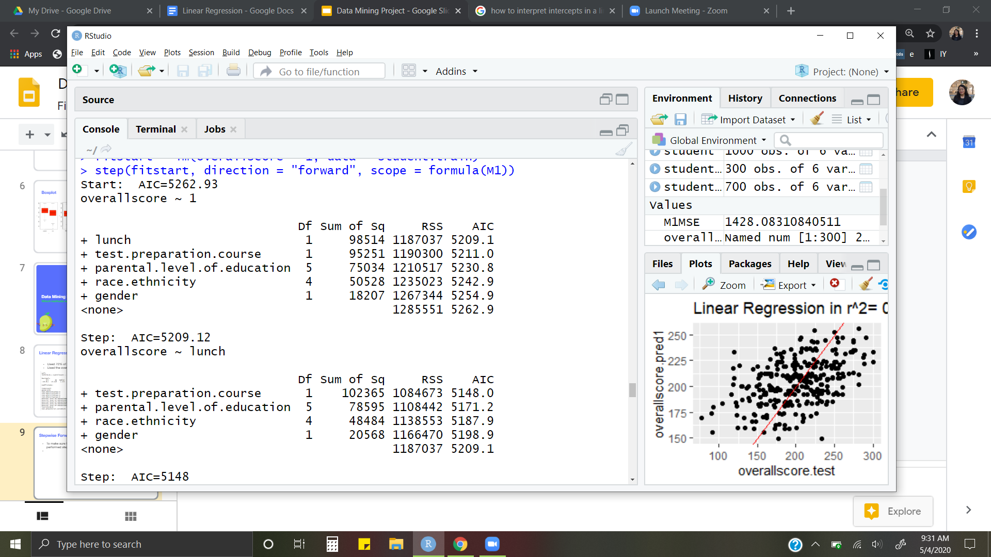
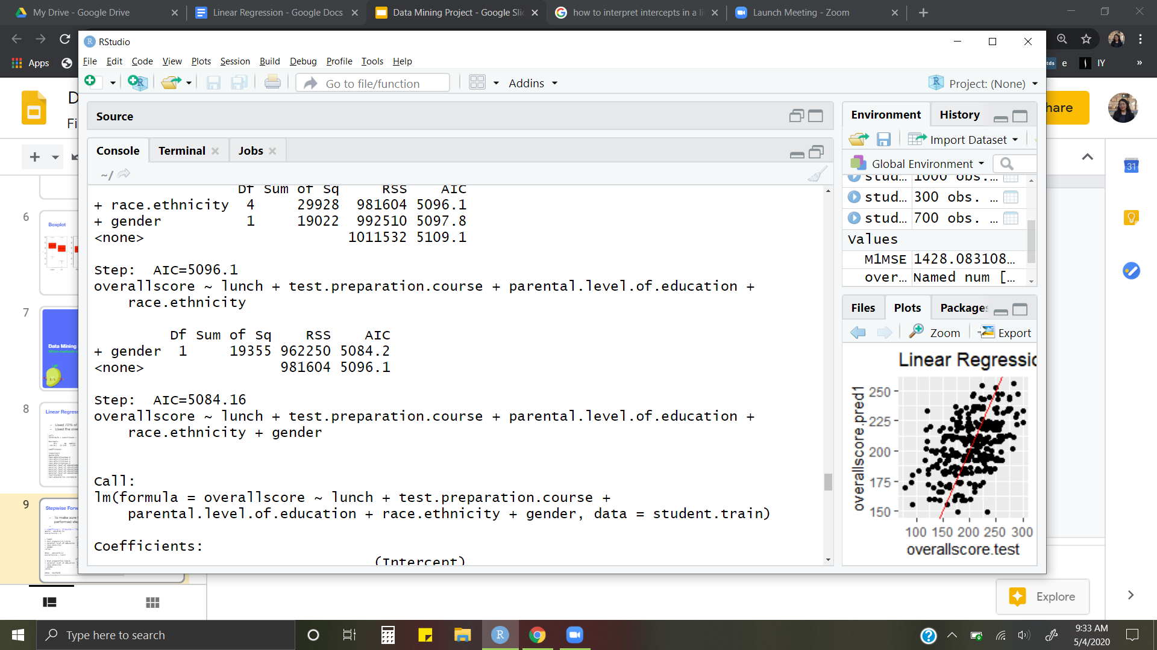
Stepwise Forward Selection

Slide 11
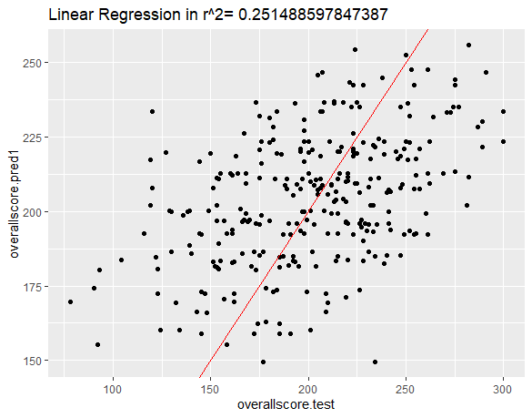
Linear Regression with Plot
The MSE is 1428

Slide 12
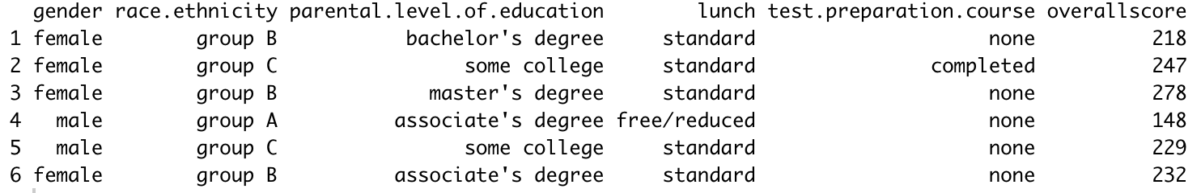
Regression Tree
1000 records with 1 continuous response “overallscore” (the total score of Math, Reading and Writing
70% training and 30% testing
Predict “overallscore” using Input - 5 categorical variables

Slide 13
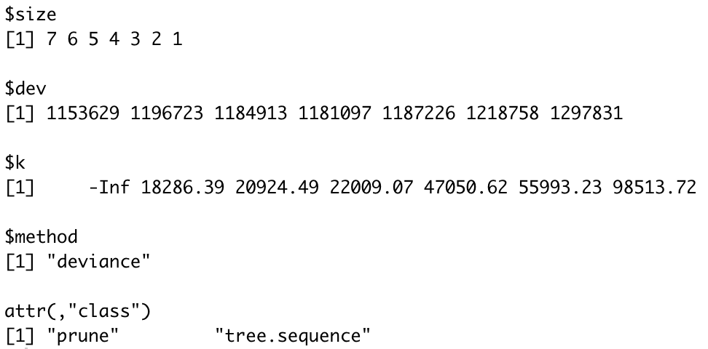
Regression Tree
Use K-fold cross-validation to determine the optimal subtree
cv.tree() function reports the number of terminal nodes of each tree considered and the corresponding error rate.

Slide 14
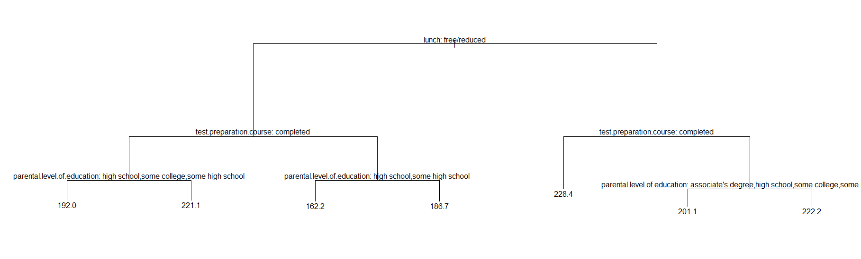
Regression Tree
MSE between True value and Predicted value is 1517.304

Slide 15
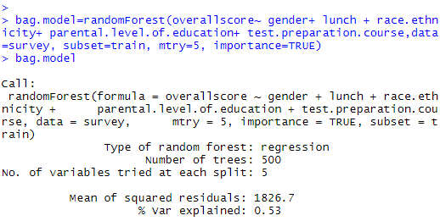
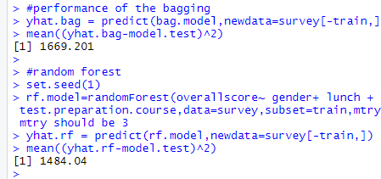
Two Ensemble Algorithms: Bagging
Bagging: improves the accuracy & stability of our Regression Tree model
Bootstrap Aggregating - sample with replacement
Bagging uses all 5 predictors:
Race
Ethnicity
Parental Level of Education
Gender
Lunch
Mean value: shows the performance of bagging
Notes:
One is based on the mean decrease of accuracy in predictions on the out of bag samples when a given variable is excluded from the model. The second is a measure of the total decrease in node impurity that results from splits over that variable, averaged over all trees.

Slide 16
Two Ensemble Algorithms: Random Forest
Random Forest: Bagging + Decision Tree
uses a random split with replacement at 2 predictors (5 / 3 = 2)
Mean value: shows the performance of Random Forest
Mean is lower for Random Forest => less errors
Random Forest: was used to help evaluate which variable was more important for the total test score
Each model’s performance was evaluated by calculating the MSE
Notes:
One is based on the mean decrease of accuracy in predictions on the out of bag samples when a given variable is excluded from the model. The second is a measure of the total decrease in node impurity that results from splits over that variable, averaged over all trees.

Slide 17
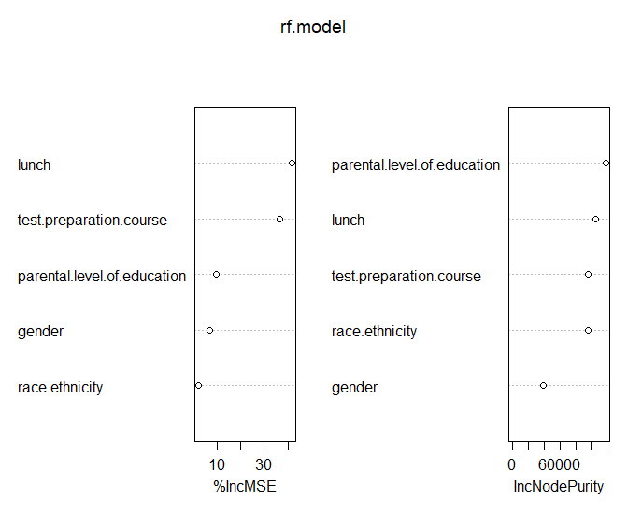
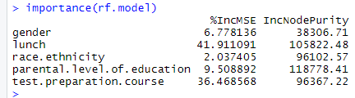
Importance of Each Variable
The importance of each variable was evaluated using:
importance() - mean decrease of accuracy in predictions
varImpPlot() - total decrease in node impurity
Lunch, test prep, parental level of education give the best prediction and contribute most to the model

Slide 18
Final Model
Choosing the optimal model

Slide 19
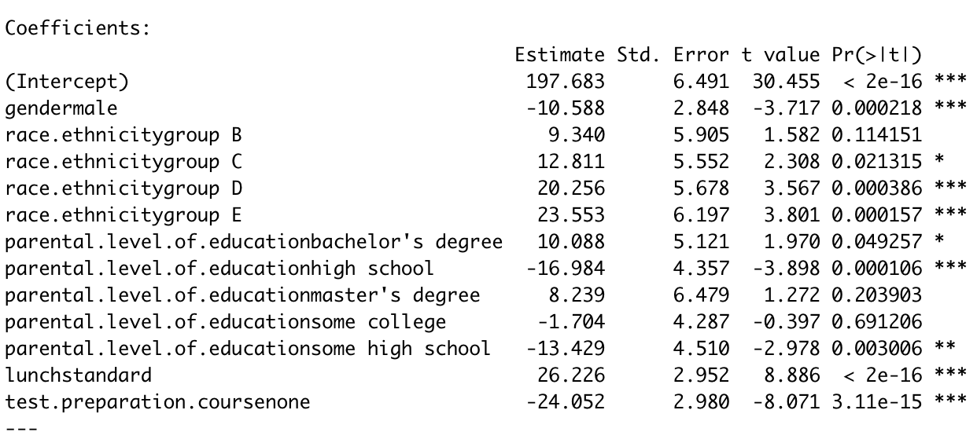
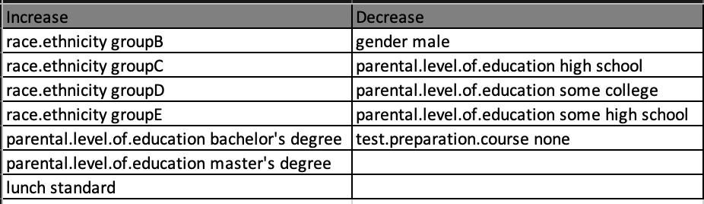
Final Model & Results
Linear regression model is the better model with lowest MSE
Is there a correlation between test prep and a higher total score? Yes
Which variable highly contributes to students exam performance? Multiple variables
Predict the overall test score from inputted variables. With all other predictors held fixed, an increase to a predictor in the increase column or a decrease to a predictor in decrease column would result to an increase to the student’s overall score.

Slide 20


Thank You!

